Slide 1
Python programming
unit 3 program practice

Slide 2
Reverse of list
Make a function, call it reverseList(). Take an argument of list type, and return a new list with all item in reversed order. --- (don’t call the list.reverse() method. Build your own version)
Make a function, call it reverseListInPlace(). Take an argument of list type, change the list items order in reverse and then return. (no need return value) --- (don’t call the list.reverse() method. Build your own version)

Slide 3
Permutation of letters
Write a program, which takes many different letters from user. Use ‘0’ as indication of end.
The program output all possible string using those letters. (use at least one letter, up to all letters been used.)

Slide 4
List Programming practice
Make a program, which takes several value as input (value 0 to indicate the end).
The program find the median value. (if total numbers is even, take the centre position 2 numbers and use average as final result. If total numbers is odd take the centre position number.)
Make a program, which takes several values from user and calculate the sum and average. (when give value 0 means the end)

Slide 5
List Programming practice
Make a program, which takes 2 list of strings, then item-wise concatenate (2 first items of the lists concatenate together, 2 second items, then 2 third items, etc.)
Example: first list: [ ‘M’, ‘na’, ‘i’, ‘Je’]; second list:[‘y’, ‘me’, ‘s’, ‘rry’]
Then the result is [‘My’, ‘name’, ‘is’, ‘Jerry’]
Make a program, which takes 1 list of numbers as items, then produce a new list with all item number are the square of original number.
Example: list: [2, 3, 4, 5]
Then the result is [4, 9, 16, 25]

Slide 6
List Programming practice
Make a program, which check a list of string, and if have empty string as item, remove it
Example: list: [ ‘Python’, ‘’, ‘’, ‘program’]
Then the result is [‘Python’, ‘program’]
Make a program, which takes 2 list of string, then concatenate the first item of first string with last item of second string, then second item of first string, and last second of second string, etc. the 2 items when concatenate add space in between.
Example: first list: [‘apple’, ‘banana’, ‘orange’, ‘mango’], second list: [‘cat’, ‘dog’, ‘mouse’, ‘monkey’]
Then the result is [‘apple monkey’, ‘ banana mouse’, ‘orange dog’, ‘mango cat’]

Slide 7
List Programming practice
Make program which can do extend nested list like following:
Have a list: [ ‘a’, [‘b’, ‘c’, [‘d’, ‘e’, ‘f’], ‘j’, ‘k’], ‘l’]
Insert a second list [‘g’, ‘h’, ‘i’] and make it becomes: [‘a’, [‘b’, ‘c’, [‘d’, ‘e’, ‘f’, ‘g’, ‘h’, ‘i’], ‘j’, ‘k’], ‘l’]
For the last program, make a new one after the second list inserted the result becomes:
[‘a’, [‘b’, ‘c’, [‘d’, ‘e’, ‘f’, [‘g’, ‘h’, ‘i’]], ‘j’, ‘k’], ‘l’]

Slide 8
List Programming practice
Remove specific value from list. example
Have a list: [ 5, 10, 20, 22, 20, 42, 50]
Then remove(list, 20) will give: [5, 10, 22, 42, 50]
Replace specific value in list with a new value. example:
Have a list: [ 5, 10, 20, 22, 20, 42, 50]
Then replace(list, 20, 200) will give: [5, 10, 200, 22, 200, 42, 50]

Slide 9
List Programming practice
Give a number, and a list of numbers.
Find from the list, 2 numbers which can add up together equal to the number given.
Given 2 list, [1, 3, 5, 7, None, None] and [2, 4, 6, 8].
Make a program to produce a new list from the 2 list given, the new list is : [1, 2, 3, 4, 5, 6, 7, 8]. (Note: you need use the two list to produce the new one, not directly generate a new one)

Slide 10
Tuple Programming practice
Take a tuple, and make a new tuple, which all items are reversed from the previous one.
Example: (10, 30, 50, 70)
Give: (70, 50, 30, 10)
Try to access the value 20 from the following tuple:
(‘abc’, [10, 20, 30], (5, 55), 30)
How to access value 55? How about value 30?

Slide 11
Tuple Programming practice
Create a tuple with one value 33
Unpack a tuple with 4 items, and give those value to 4 variables
Example: (‘a’, ‘b’, ‘c’, 40)
User var_1, var_2, var_3, var_4 as name for 4 variables.

Slide 12
Tuple Programming practice
Sort tuples according to the value of second item:
Example : ((‘dog’, 20), (‘cat’, 10), (‘monkey’, 40), (‘mouse’, 5))
After sorted: ((‘mouse’, 5), (‘cat’, 10), (‘dog’, 20), (‘monkey’ 40))

Slide 13
dict Programming practice
Make dict from a list of keys and a list of values:
Example : keys = [‘one’, ‘two’, ‘three’, ‘four’], values = [100, 200, 300, 400]
Produce target dict: {‘one’: 100, ‘two’: 200, ‘three’: 300, ‘four’: 400}
Merge 2 dict:
Example : dict1 = {‘one’: 100, ‘two’: 200}, dict2 = {‘three’:300, ‘four’:400}
Produce target dict: {‘one’: 100, ‘two’: 200, ‘three’: 300, ‘four’: 400}

Slide 14
dict Programming practice
Find Tom’s math mark from following dict:
sample_dict = {‘class’: {‘students’: [{‘name’: ‘Tom’, ‘marks’: {‘math’:89, ‘English’: 75} }, {‘name’: ‘Jerry’, ‘marks’: {‘math’:60, ‘English’: 90} ] } }
How about find Jerry’s English mark?

Slide 15
dict Programming practice
Create a dict, using a list of keys, and one default value for all keys
Example: keys = [‘Alice’, ‘Emma’], default_value = {‘age’: None, ‘address’: None}
Produce a dict: {‘Alice’: {‘age’: None, ‘address’: None}, ‘Emma’: {‘age’: None, ‘address’: None} }
Check if one specified value is in dict
Example: {‘a’: 100, ‘b’: 200, ‘c’: 300}
Check value 200, it should give “True, 200 is in dict”

Slide 16
dict Programming practice
Create a new dict from existing dict, which take part of keys
Example: keys = [‘Alice’, ‘Emma’], dict1 = {‘Alice’:14, ‘Tom’: 12, ‘Jerry’: 10, ‘Emma’: 16}
Produce a dict: {‘Alice’: 14, ‘Emma’: 16 }
Update a dict, remove some of the keys:
Example: keys = [‘Alice’, ‘Emma’], dict1 = {‘Alice’:14, ‘Tom’: 12, ‘Jerry’: 10, ‘Emma’: 16}
Produce a dict: {‘Tom’: 12, ‘Jerry’: 10}

Slide 17
dict Programming practice
Compare a dict items and find smallest one
By default dict will compare items using key
a dict: {‘Alice’:14, ‘Tom’: 12, ‘Jerry’: 10, ‘Emma’: 16}
Find the smallest (min()) will give: ‘Alice’
Change dict compare using value:
Give min() function one additional parameter: key=compare_func
Find the smalles will give: ‘Jerry’

Slide 18
Make a program, which accept a long sentence from user.
Then program output the same information got from use.
Then program output how many different characters inside this sentence.
Then the program output the sentence but remove all whitespace (space ‘ ’, tabs ‘\t’)

Slide 19
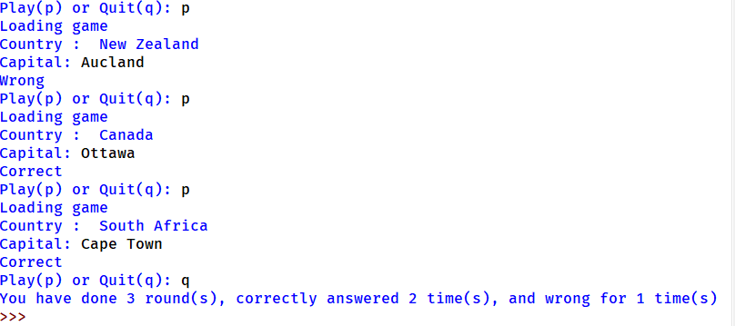
Country-capital game
Computer has a list of many countries and their capital cities.
The game challenge to the player is can remember what is the capital city of specified county. Computer will give the country name and ask player to answer.
After many rounds, when player quit play, computer gives the result of how many correct, how many wrong.

Slide 20
Word counting program
Read one article (one file) from stdin or as file.
Analyse the words in the article: count how many times appeared for each word

Slide 21
String pattern
Make a program which can format string with specified pattern. Example:
You have 2 string data, call them ‘a’ and ‘b’. For example a = ‘Welcome’, b=‘toMalaysia’
Give a pattern, for example ‘abba’.
The program will use the 2 string data and make new string according to the pattern, finally produce result: ‘WelcometoMalaysiatoMalaysiaWelcome’

Slide 22
Programming practice
Make a program, which takes input from user about a day (year-month-day), then give the next date. Example:
Input a year: 2016
Input a month [1-12]: 08
Input a day [1-31]: 23
The next date is [yyyy-mm-dd] 2016-8-24

Slide 23
Judge number is even or odd – use recursion
Number is 1, it is odd
Number is 0, it is even
For any number n, it is same even or odd as n-2
Use the above rule to define a function, which can recursive call and give a judgement one number is even or odd.
Test your function.

Slide 24
Number puzzle
Number sequence.
The first number is 1.
The next number is calculated based on the previous number. You can either choose to multiply by 3, or choose to add by 5.
Now give a number, can you make a program to judge if this number is inside one of the above sequence? If it is can you find a sequence which can produce this number?

Slide 25
nestsum
Create a function called nestsum.
The function takes a list and if the list has nested lists, will sum over all of them (nested lists) and calculate the sum of all items.

Slide 26
File operation
You have many files, each file contains synonyms for one word. For example, for word ‘educate’, the file ‘educate.txt’ will have all synonyms for it, and is ordered in line, each line start with one letter.
Inside educate.txt:
When input:
Program will output:
better
coach cultivate
drill develop
enlighten edify elevate
guide
instruct inform inculcate indoctrinate improve
prepare prime
school
teach tutor train
upskill uplift
educate
c
educate
h
coach cultivate
No synonym begin with “h”

Slide 27
combination
Combination: how many ways to take out things from a set of items.
You have {a, b, c, d, e}, 5 things.
Now you want take out 1 from the 5. how many ways you can do? Answer: you have 5 ways.
Now you want take out 2 from the 5. how many ways? Answer: Then total ways is 10. they are {a,b}, {a,c}, {a,d}, {a,e}, {b,c}, {b,d}, {b,e}, {c,d}, {c,e}, {d,e}
Make a program to list all the ways? (from n items to take m items, m<=n)

Slide 28
permutation
In the combination problem, if the item you take out the order is important, then it becomes permutation problem.
Example: for taking 2 items, {a, c} and {c, a} are considered different.
Can make a program to list all ways?

Slide 29
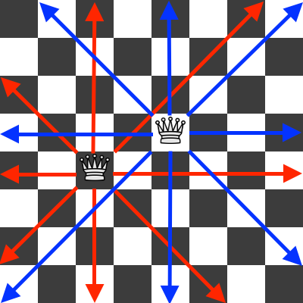
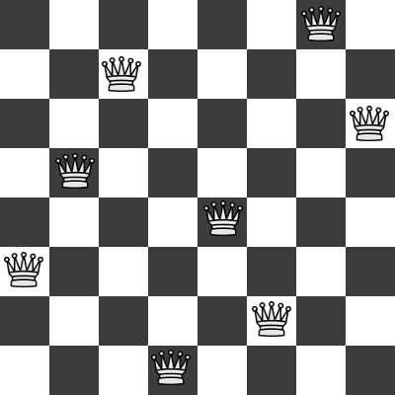
8 Queen puzzle

Slide 30
Queue simulation program
Create a program of simulation.
Every minute comes a random number person of (0~5), to queue and buy coffee.
Every guest takes around 15 ~ 20 seconds to finish service.
Observe how the queue depth changes with time.
Record and study each person’s waiting time.

Slide 31
stack simulation program
Create a program of simulation.
Every day comes a random number of files waiting to be signed (0~10), which was put on a table.
Every day take 6 files from table, process and sign it.
Observe how the stack depth changes with time.
What if you feel not work and work efficiency reduce to only process 4 files one day?
Record and study each file waiting time.

Slide 32
What is in the backpack
Create 2 players for the game. Each player has 4 items in his/her backpack
Each player plays in turn. When one player plays, guest what is in the other player’s backpack. If guess correct, that item was removed from other player’s backpack.
Until one player’s backpack is empty, he/she lose the game.

Slide 33
Flow chart for the game
START
2 player user name and backpack items
One round play: user 1 guess
Y
Correct guess?
Update score, remove user 2 backpack
N
One round play: user 2 guess
Y
Update score, remove user 1 backpack
Correct guess?
N
Any user backpack all finish?
Y
N
Next round?
Y
N
Show score and results
END

